Slide 1
Data Analytics and Visualization Final Project
NY citiBike Program: Bike Availability Predictor
Sarah Mwanzi
Soumya Patil

Slide 2
Project Overview
NYC citiBike:
A bike share program with stations throughout NYC that a rider can pick up and return a bike to.
Previous Project:
Analysis of usage and popular stations/trips
Problem:
No available bikes at popular stations during popular times
Goal:
Given a start station and time of day/ day of week for a trip start, predict the availability of a bike at the start stations using Machine Learning Models.

Slide 3
Data Overview
Real –Time Data was scraped from https://www.citibikenyc.com/system-data .
Scraped using python script/ SQLAchemy and stored in Postgres / uploaded to AWS 3
minute-by-minute update of the number of bikes and number of docks available
trips: trip-level records, includes date, start/end time, start/end station ID, start/end station name, bike ID, rider subscription type, and trip duration

Slide 4


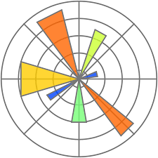




Project Requirements:
Technologies used:
Scikit-Learn
Python Pandas
Python
Matplotlib/Seaborn
PostgreSQL
Amazon AWS
Numpy
SQLAlchemy

Slide 5
Exploratory Data Analysis
Paired Scatter Plot
No clear correlation between the variables.
The data set meets the requirements of a classification model

Slide 6
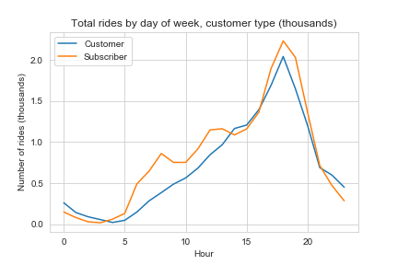
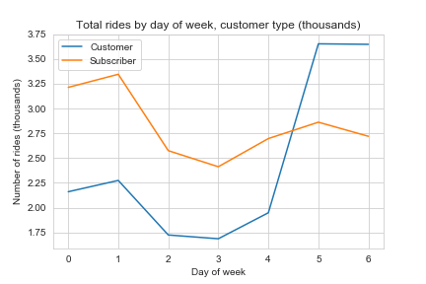
Exploratory Data Analysis
Ridership Trends
Ridership peaks early to late evenings
Mondays and Weekends see the most riders

Slide 7
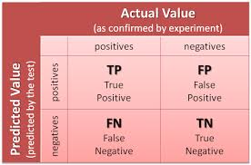
Machine Learning Models:
Classifiers
Logistic Regression
Random Forest
SVC
K-Neighbors

Slide 8


Assumptions
Binary logistic regression - the dependent variable is binary.
The factor level 1 of the dependent variable represents the desired outcome.
Only meaningful variables should be included.
The independent variables are independent of each other, the model should have little or no multicollinearity

Slide 9
Challenges/limitations
Setting up the data scraping scheduler.
Needed at least a 2 weeks of data
Data processing – dates and timestamps conversions.
Time constraints.

Slide 10
Future projects
HEADLINE TEXT
This dataset holds rich potential for further feature engineering, including:
Adding weather features and Mapping zip-level daily weather data with each station
Using data over a longer period.
Creating a citibike availability predictor application

